Slide 1
Team 16
Knuckles, The Assistive Robotic Arm
Andrew Blanchard (Team Leader), Matthew van Zuilekom, Rym Benchaabane, Paola Hernandez
ECE 4336: ECE Design II
Faculty: Dr. Dmitri Litvinov
Faculty Advisor: Dr. Becker
Friday, April 26th 2019
Sponsored by IEEE UH Makers
Notes:
Andrew

Slide 2
Overall Project
What is Knuckles?
Stationary, 3D printed voice activated assistive robotic arm that will hand the user objects and tools upon request
Home robot
Purpose
Assist those who are limited in physical capacity
Decrease the risk of dexterity incidents
Increase the user’s productivity
Examples of users
Elderly
People with disabilities
Lab researchers
Notes:
Andrew

Slide 3
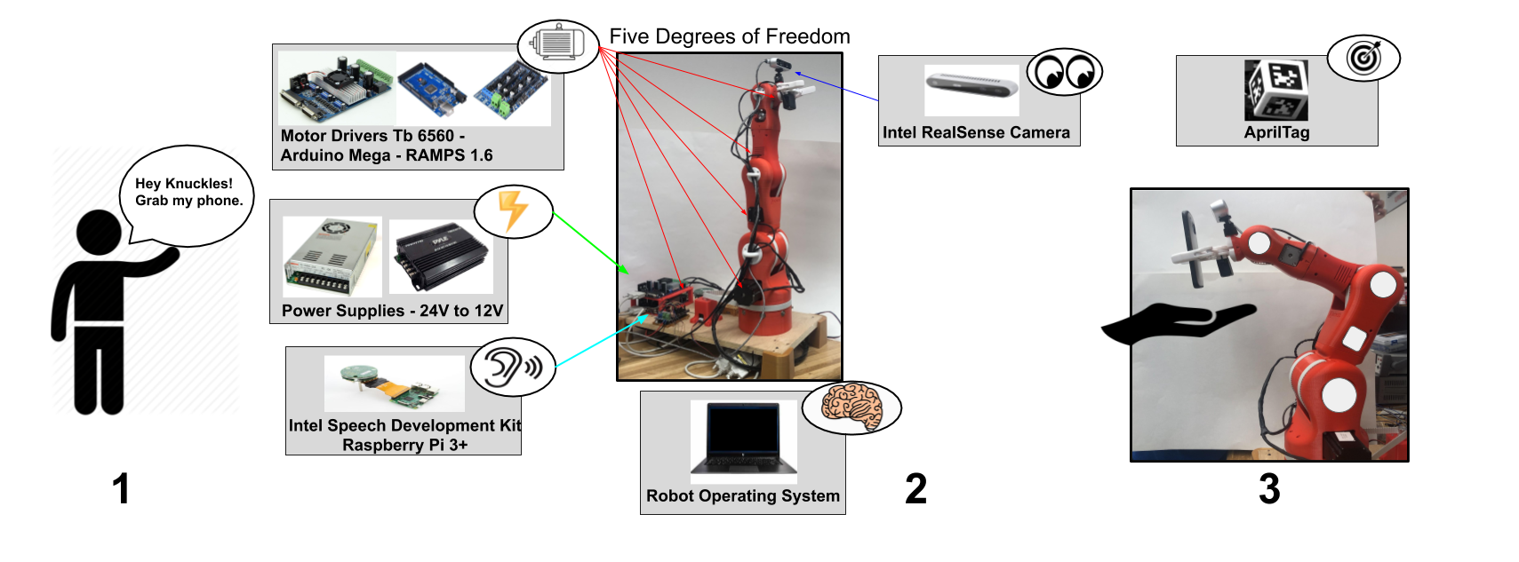
Overview Diagram
Figure 1. Overview of Knuckles functionalities
Notes:
Andrew

Slide 4
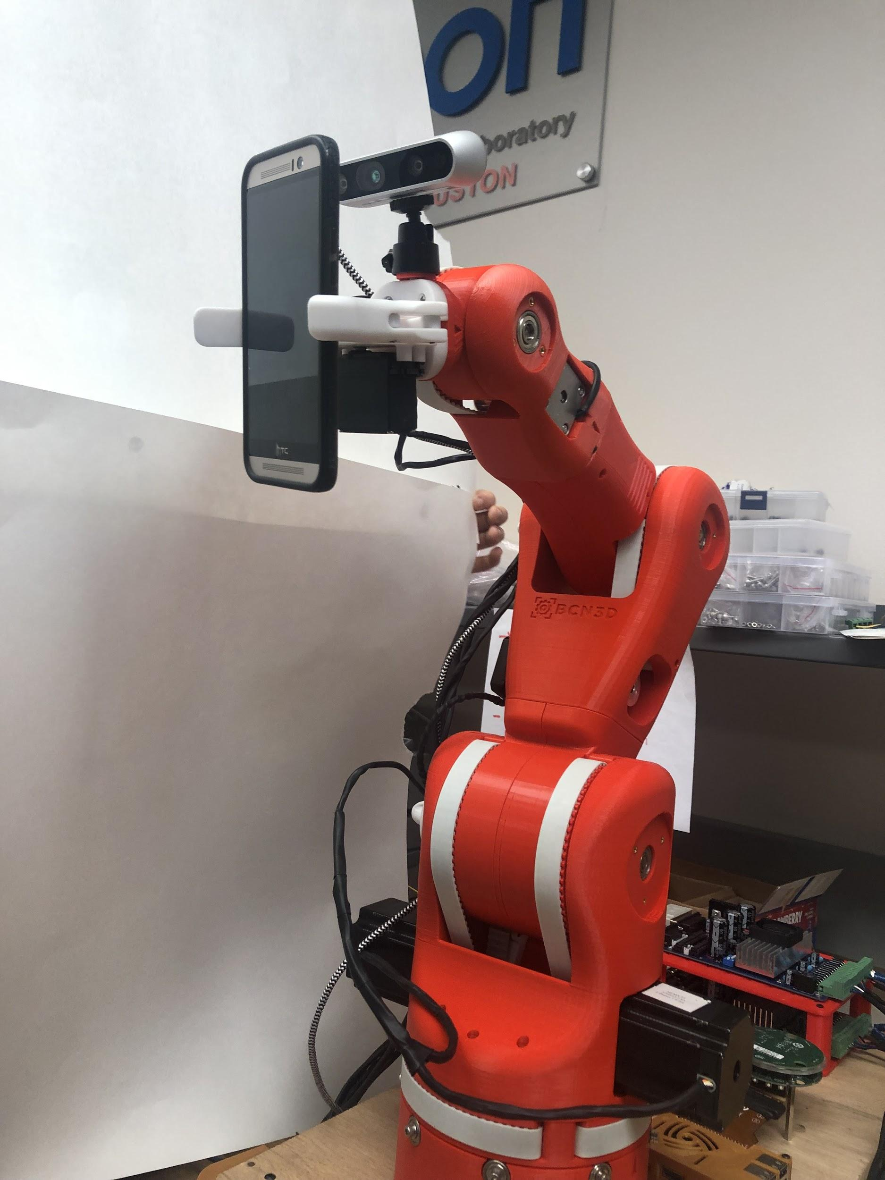
Related Patents
Patent 2: 8,077,963 B2
Mobile robot with a head-based movement mapping scheme
Our project will not be patented but will be open-source.
Patent 1: US 10,242,334 B2
Machine Readable Delivery Platform for automated package delivery
Patent 3: 10,223,732 B2
Identifying Items in Images
Figure 2. Knuckles holding a phone

Slide 5
Design Considerations
Starting point:
BCN3D Moveo, open-source 3D-print design from a 3D printing company in Barcelona that was based off another robot built for a Hack-a-day project
Project is a proof-of-concept, not an alpha prototype
Notes:
Matthew

Slide 6
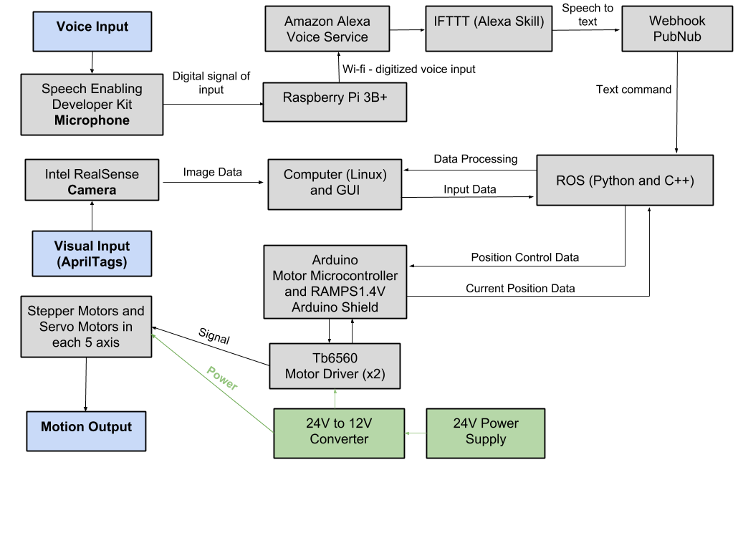
Design Considerations
Figure 3. Modular Diagram of Knuckles system
Notes:
Matthew:
24V/12V converters: Step down 120VAC to 24VDC and 12VDC. 24V connects to larger motors, 12V connects to smaller motors.
Connect to 120V mains: Home robot. Connection to 120VAC mains allows Knuckles to be used in any home.
Chose Tb6560 instead of original BOM stepper motor drivers to accommodate overheating system and centralize wires/cables. Also the stepper drivers have 3 axises each, so we only needed to use 2 stepper drivers.
Arduino microcontroller + RAMPS 1.4V: Easily program motor control, RAMPS 1.4V as a shield to protect arduino against high voltage.
BOM was also available, we modified to accommodate our specs

Slide 7
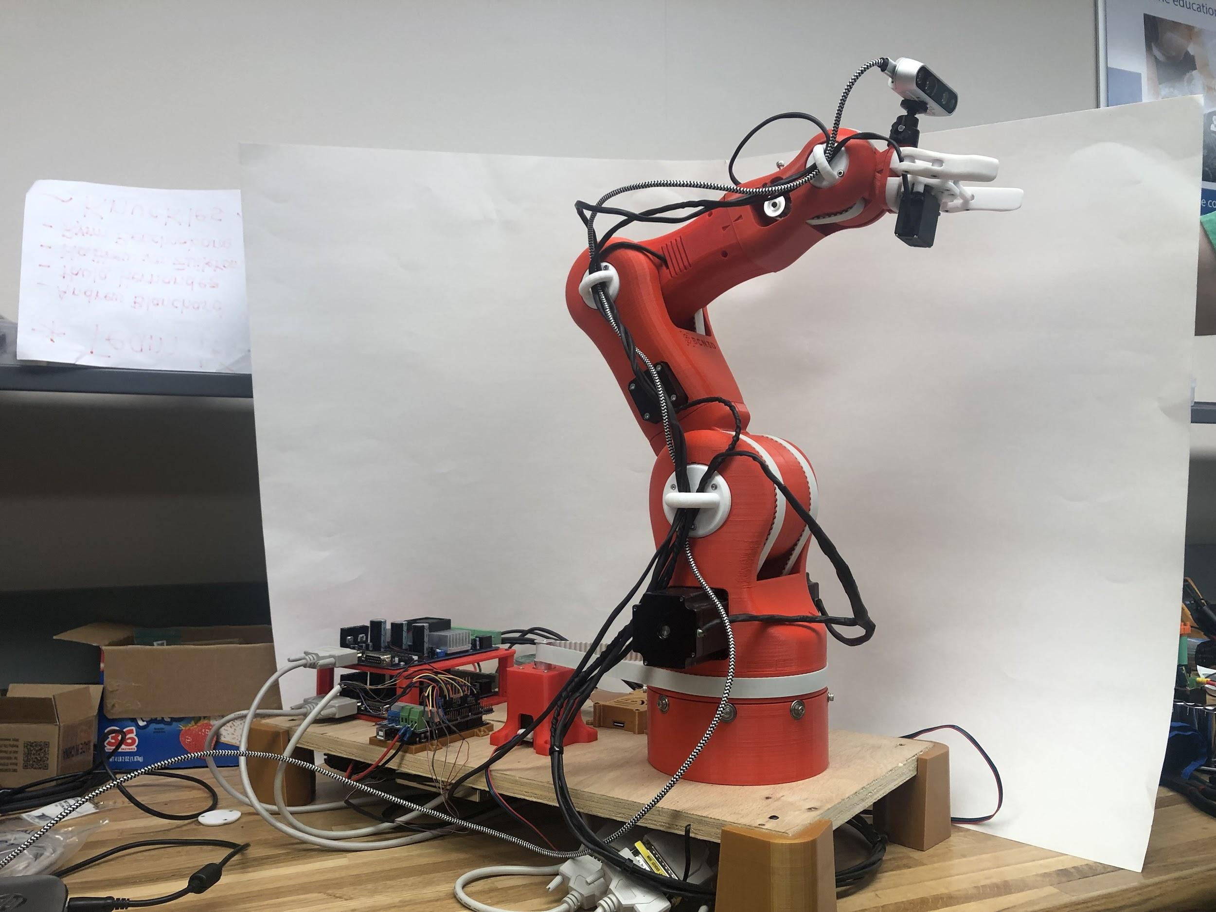
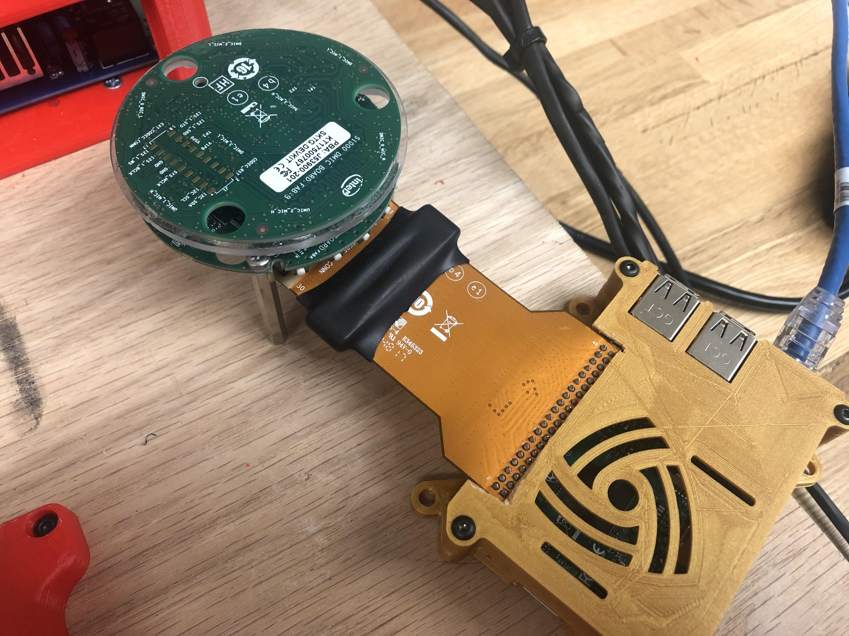
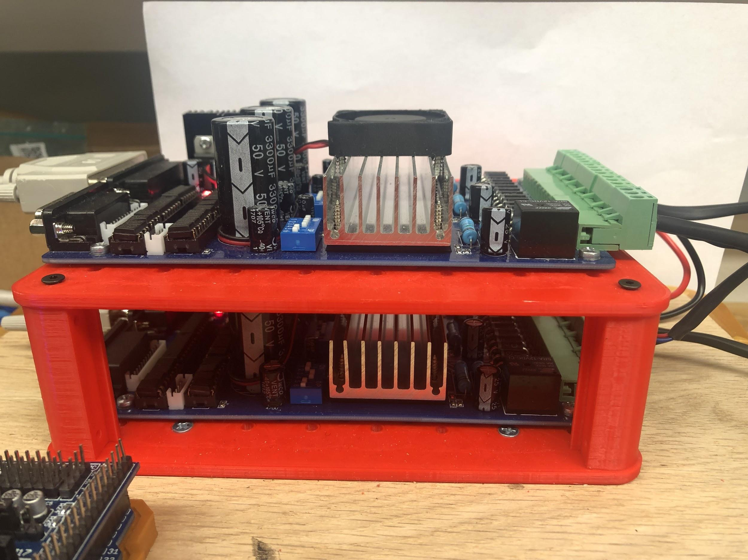
Design Considerations
Wooden base and 3D printed cases to protect equipment
Ring shaped taps to better wire routing
Two Tb6560 instead of six (BOM)
Figure 4. Microphone & 3D-printed cased Raspberry Pi 3B+
Figure 5. Tb6560 Stepper drivers
Figure 6. Knuckles in default position

Slide 8
Design Constraints
Overheating motors. Needed a larger base motor
Current divider using switches on stepper drivers
Two-finger gripper reduces grab capabilities
Limited objects to grab
Limited range of reach (0.5 m)
Stationary robot
Notes:
Paola

Slide 9
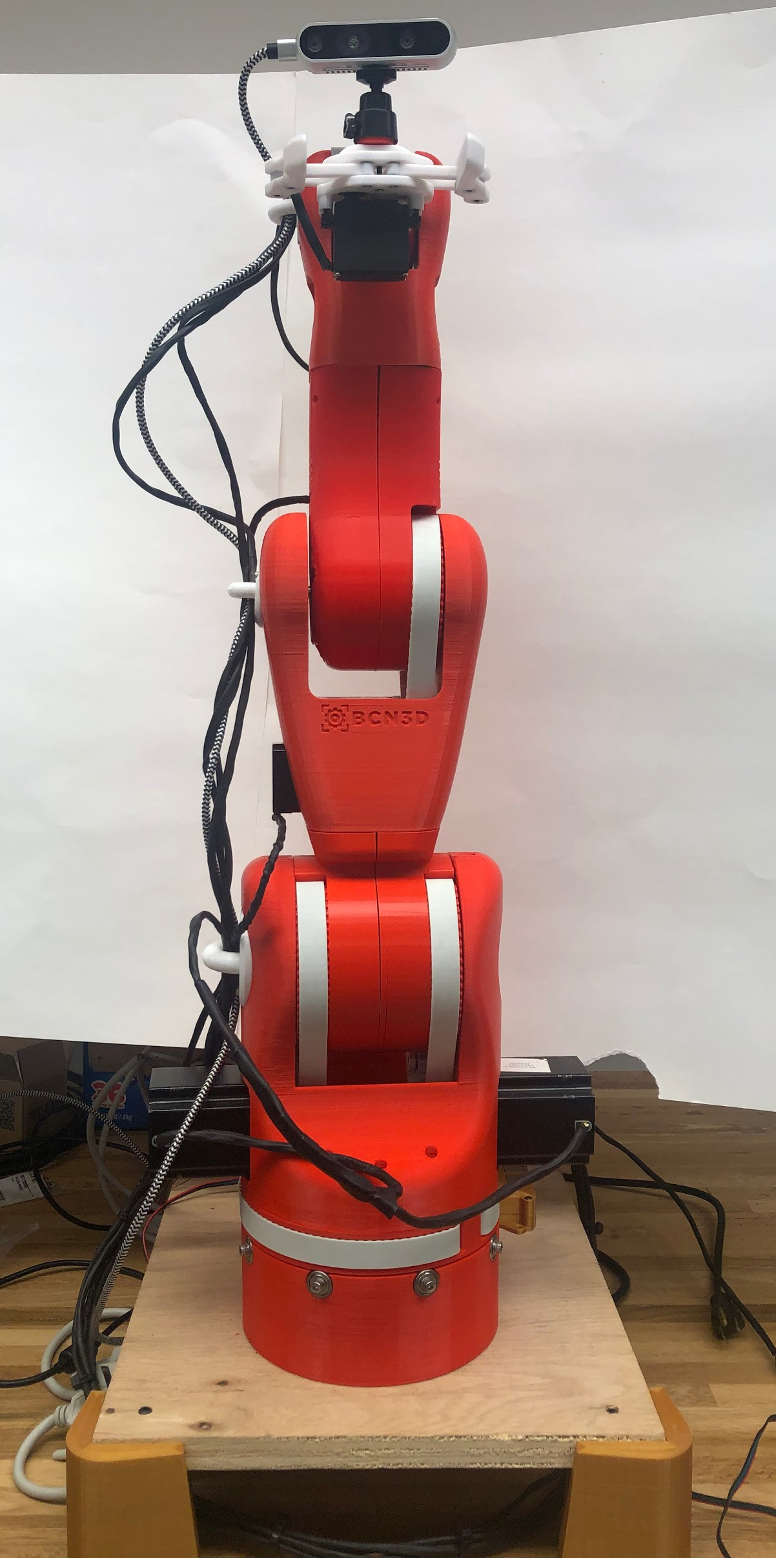
Design Constraints
Table 1. Torque calculations to choose motors
Link | Length (cm) | Part and Motors Mass (kg) | Total Torque (N.m)
5 | 17.5 | 0.849 | 0.110
4 | 12.6 | 0.690 | 0.216
3 | 22.2 | 0.640 | 2.08
2 | 22.2 | 3.20 | 6.00
1 | 16.8 | 1.00 | 0.710
Link 5
Link 4
Link 3
Link 2
Figure 7. Knuckles in upright position
Link 1
Goal: maximum weight rating = 0.5 kg
Notes:
3.6 N.m

Slide 10
Deliverables
Table 2. Expected deliverables from Fall semester
FALL 2018 | WINTER BREAK | SPRING 2019
Assembling: Physical arm and gripper prototype 1 (100%) | Assembling: Tune gripper and arm motors motion (90%) | User Interface: Develop a Graphic User Interface (QTdesigner)
Hardware Purchased: (Intel RealSense camera, Intel mic, tactile pads) (100%) | Hardware Implementation Mount and install on Arm (Intel RealSense camera, Intel mic, tactile pads) (50%) | Automation Control: Arm moves using data from ROS (50%)
Object Detection: Recognize the AprilTag and associate it to an object (100%) | Object Detection: Arm follows the AprilTag (90%) | Voice Recognition: Convert voice to speech speech to object detection (15%)
Simulation: Arm functions on RViz (100%) | Communication System: Receive Feedback Signals from all hardware on ROS (100%) | Physical arm Prototype 2
Notes:
Andrew

Slide 11
Deliverables
Table 3. Deliverables at the end of Spring semester
 | SPRING 2019
Assembling: Tune gripper and arm motors motion (100%) | User Interface: Develop a Graphic User Interface (QTdesigner) (85%)
Hardware Implementation Mount and install on Arm (Intel RealSense camera, Intel mic) (100%) | Automation Control: Arm moves using data from ROS (100%)
Object Detection: Arm follows AprilTag (100%) | Voice Recognition: Convert voice to speech speech to object detection (100%)
Communication System: Receive Feedback Signals from all hardware on ROS (100%) | Physical Arm Final Build: (100%)
SPRING 2019

Slide 12
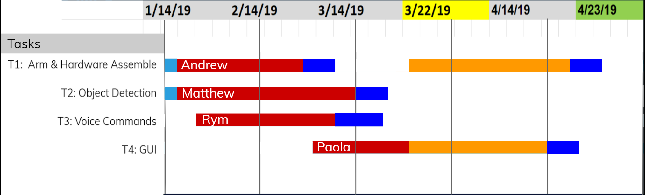
Prototypes & Schedule
LEGEND
Deadlines
Prototype Demo
Prototypes
1
3
ECEDHA Conference
Delay
2
Figure 8. Gantt Chart
Notes:
Converted Knuckles from prototype to proof-of-concept.
-started in June. Had to learn EVERYTHING from scratch Machine learning. Removed since Apriltags are hard-coded
Object detection with OpenCV and Tensorflow. Replaced with Apriltags.
-Face recognition. Creating own voice recognition, so Knuckles would find the user
Depth camera. Removed since Apriltags provide distance. This is why we got RealSense
UR3. Was not provided so we had to build Moveo.
Touch sensors. Object can be pulled away from Knuckles easily
Multidirectional microphone. Originally planned to have Knuckles point towards the user

Slide 13
Test Plan
Robotic Arm:
Test each motor (link) with pulleys (6 links total)
Test gripper with different objects
AprilTag Detection:
Test for correct tag distance, orientation and ID on Rviz and ROS
Test for text commands on ROS
Voice Commands:
Test for correct voice command on Raspberry Pi3+
Test for communication system with PubNub and ROS
GUI:
Test if text commands, camera and error display matches ROS and Rviz

Slide 14
Specifications
Degrees of Freedom (DOF) Arm – Five
Accuracy Voice Interpretation – 95%
Minimum Voltage for Motors – 12V
Object Detection – AprilTags
Object Count Library – 9
Response phrases - 64
Response Time – 7 seconds
Maximum Grabbing Reach – 0.5 meter
Maximum Weight Rating – 0.5 kg
Notes:
Paola

Slide 15
Features
Powered by Mains – Yes
Integrated Microphone – Yes
Integrated Camera – Yes
Object Detection with AprilTags
Voice-Controlled using Alexa Voice Service – Yes
User-Friendly GUI – Yes
Wi-Fi required – Yes
Notes:
Paola

Slide 16
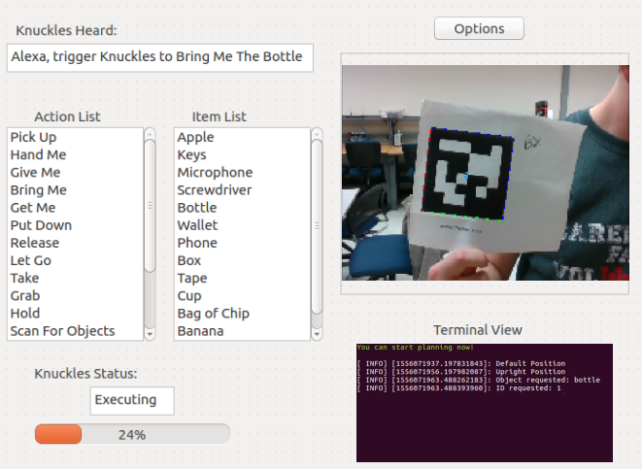
Graphical User Interface (GUI)
Figure 9. Knuckles graphical user interface
Notes:
Paola

Slide 17
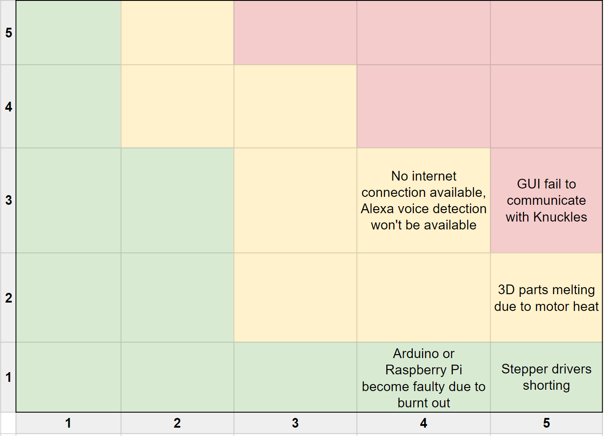
Risk Management Matrix
Damage during shipping
Unexpected risk
Probability
Consequence
Figure 10. Risk management matrix
Notes:
Matthew

Slide 18
Risk Mitigation
GUI fail to communicate with Knuckles
Use speech-to-text
No internet connection available, Alexa voice detection unavailable
Use text input instead of voice
3D parts melting due to motor heat
Re-print melted parts and/or replace motors
Stepper drivers shorting
Have four extra stepper drivers as replacements
Arduino or Raspberry Pi become faulty due to burnt connections
Get replacements at Library Makerspace
Damaged arm due to shipping packaging*
Reprint damaged parts
Notes:
Matthew

Slide 19
Conclusion
Thank you IEEE UH Makers, Dr. Roysam & Dr. Becker!
Summary
Proof-of-concept
Assistive robotic arm, increase productivity
Great opportunity to learn about robotics, Linux & ROS
Future works
Implementation of object detection and recognition
Enhancement of position awareness using limiters and encoders
Conversion of Knuckles to a mobile robot to expand uses
Upgrade Knuckles' gripper to adapt to a wider range of object shapes
Improvements on searching methods for user using the multi-directional microphone
Lessons learned
Systems integration, verification and testing
Risks management and patent search
Delegate tasks based on individual skill-set
Notes:
Paola

Slide 20
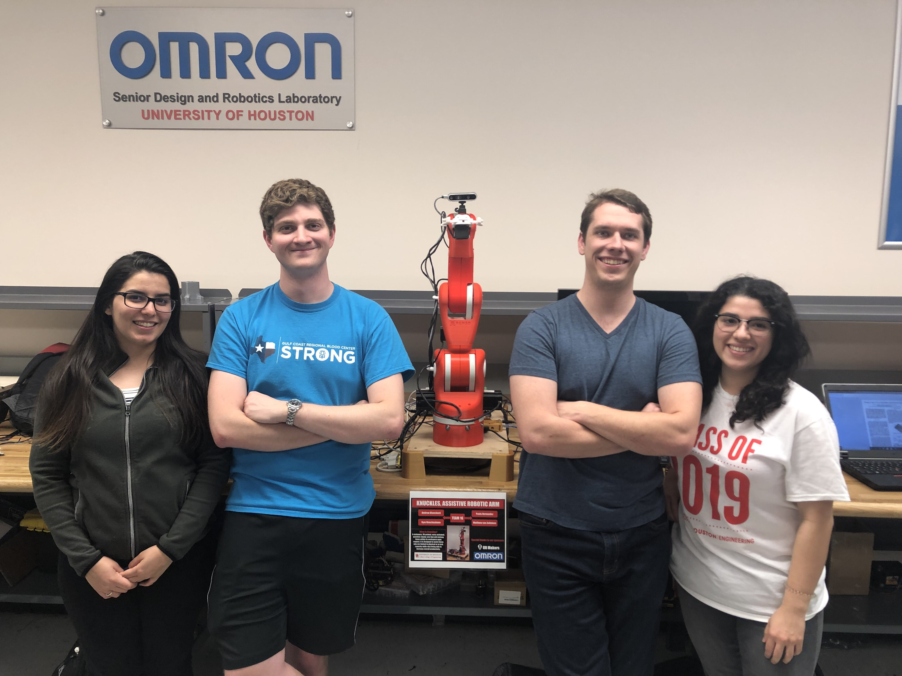
Thank you for your attention!
QUESTIONS OR COMMENTS?
Notes:
Yay

Slide 21
References: Voice Commands
Knuckles activates with: "Alexa trigger Knuckles to"
Objects aka April Tags
"Apple"
"Bottle"
"Wallet"
"Phone"
"Box"
"Tape"
"Cup"
"Bag of Chips"
“User”
From Workspace to Knuckles
"Pick up"
From Workspace to User
"Hand me"
"Give me"
"Bring me"
"Get me"
From Knuckles to Workspace
"Put Down"
From Knuckles to User
"Release"
"Let Go"
From User to Knuckles
"Take"
"Grab"
"Hold"
Knuckles Settings
"Scan for objects"
"Go Upright"
"Go Down"
"Default"
"Stop"
"That it recovered"
"Forget saved objects"
"Restart"

